Slide 1
Neural Networks: Foundations to Generative AI
Model Fitting & First Examples

Slide 2
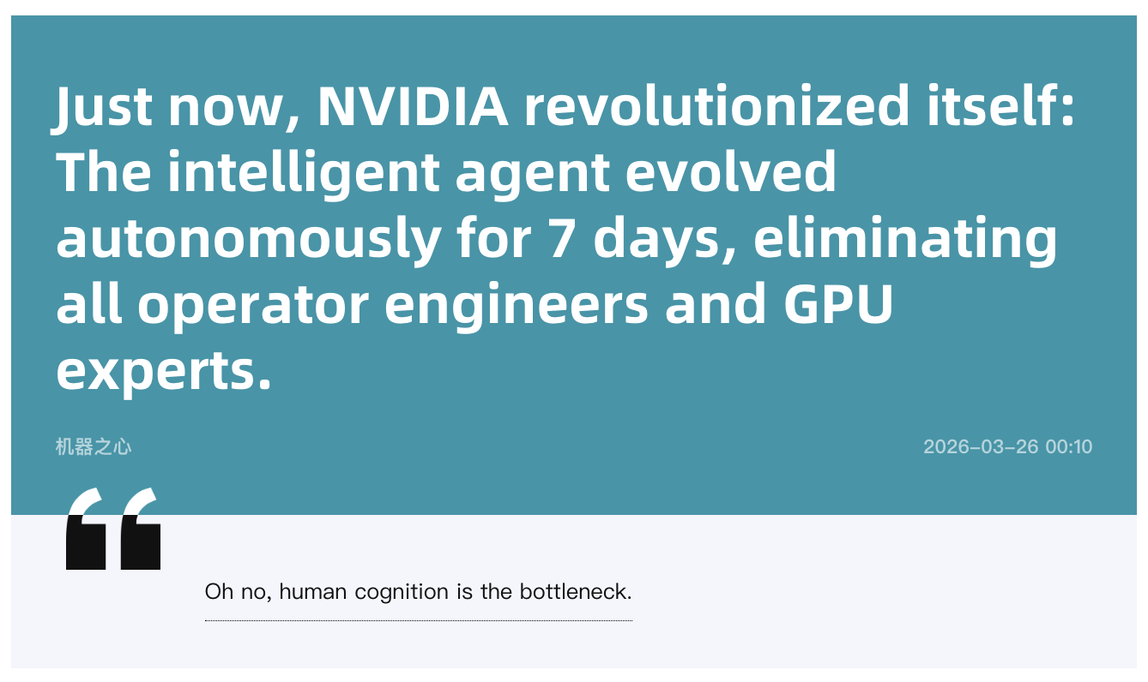

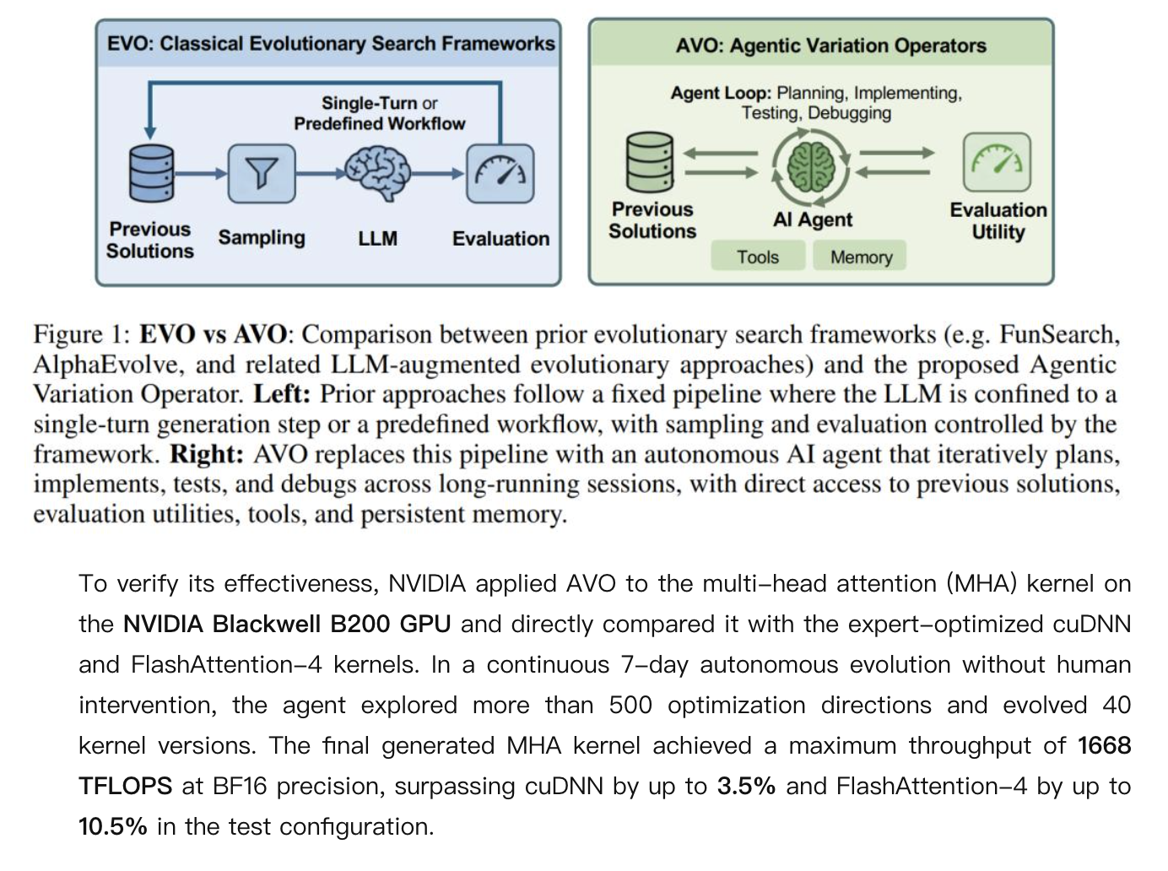
What’s In the News?

Slide 3
This Week’s Agenda
News
First Hands-on Examples
Predicting labels in synthetic data and fitting pure noise.
Boston Housing home-value prediction.
Predicting review valence / stars from text.
Detecting fake reviews.
Dealing with Overfitting
Introducing Assignment 1
More on the Final Project Proposal

Slide 4
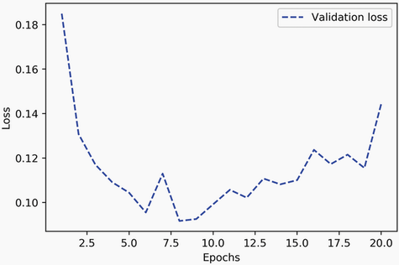
Early Stopping
Monitoring Validation Performance and then Manually Limiting Epoch Count
This is the sole approach we have been taking thus far. Can implement automatically using Keras callbacks (more on this later).

Slide 5
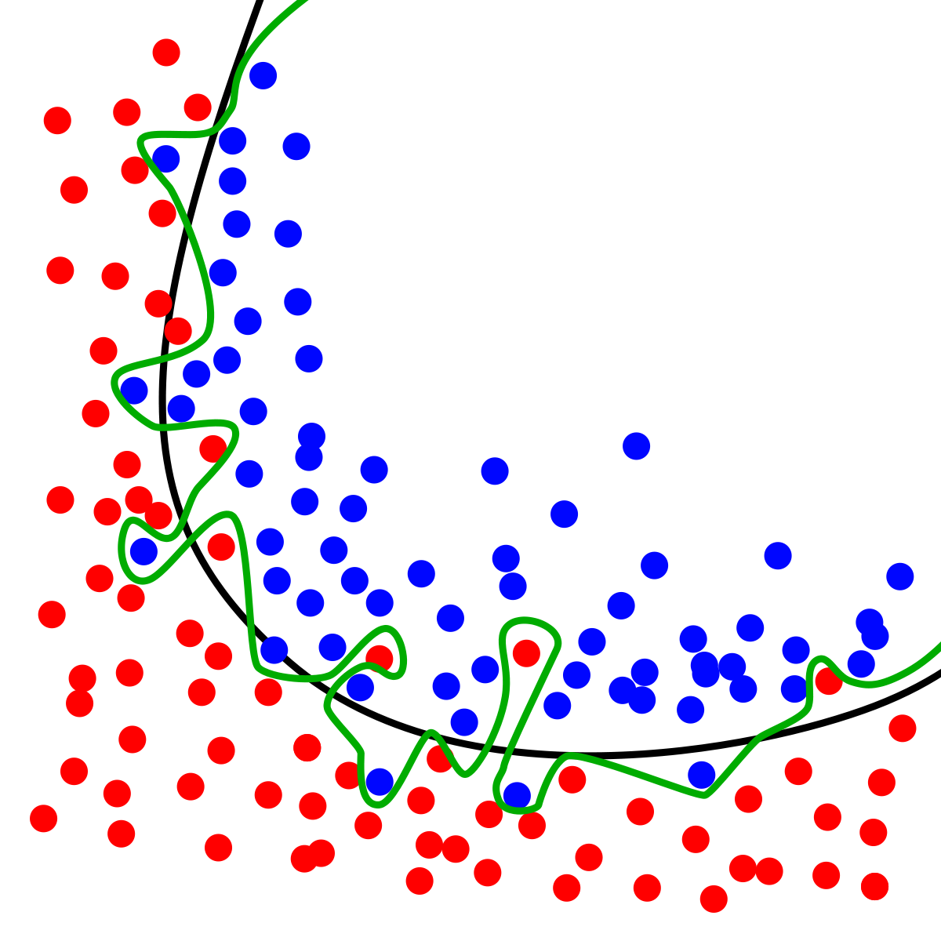
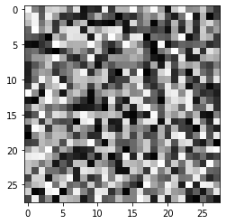
Overfitting
A Neural Network Can Easily Overfit…
Let’s look at an extreme case…

Slide 6
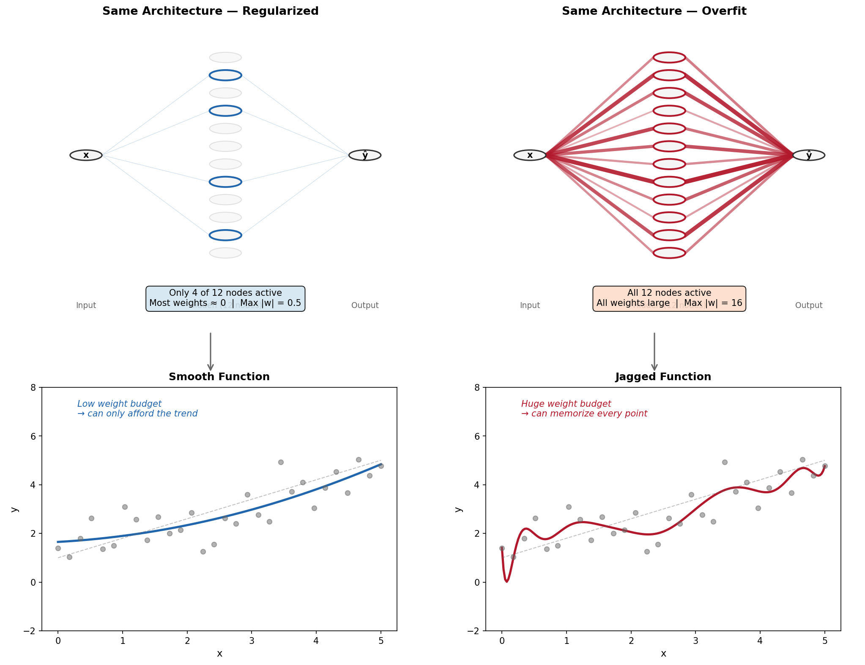
Overfitting Means Bigger Weights!

Slide 7
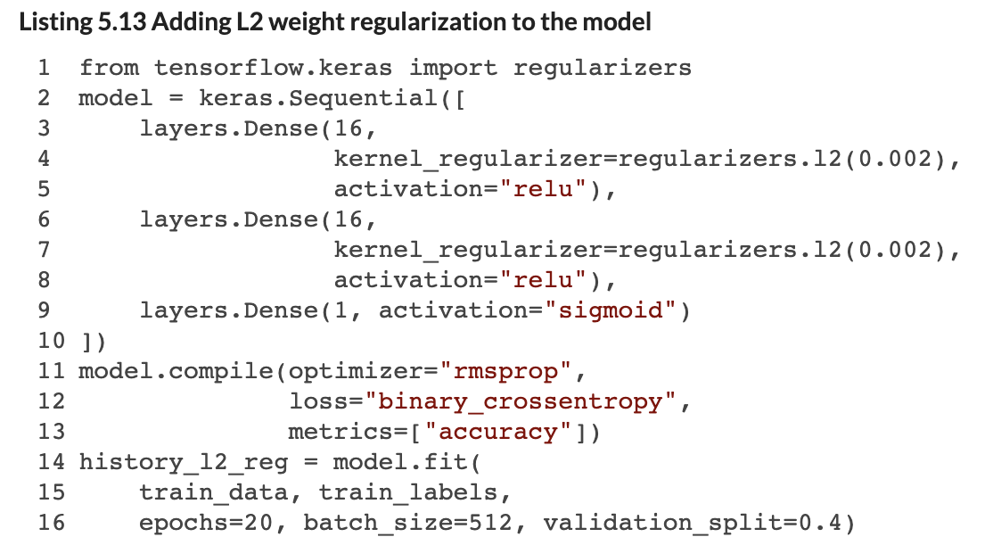
Regularization Keeps Weights Small
Regularization via Weight Constraints
Regularizing a layer’s weights means the model is less inclined to increase big weights. Both L1 or L2 norms can be used here applied.

Slide 8
What ‘Enables’ Overfitting?
Idiosyncratic Noise in Data
Over-fitting is driven by the network ‘latching on’ to idiosyncrasies in the training data that happen to associate with certain outcomes.
To solve this, in training, we can add noise / perturbations to the training data, to prevent it from latching onto those idiosyncrasies, so it sticks to more general rules.
Note: with too much noise, learning general rules gets hard!

Slide 9
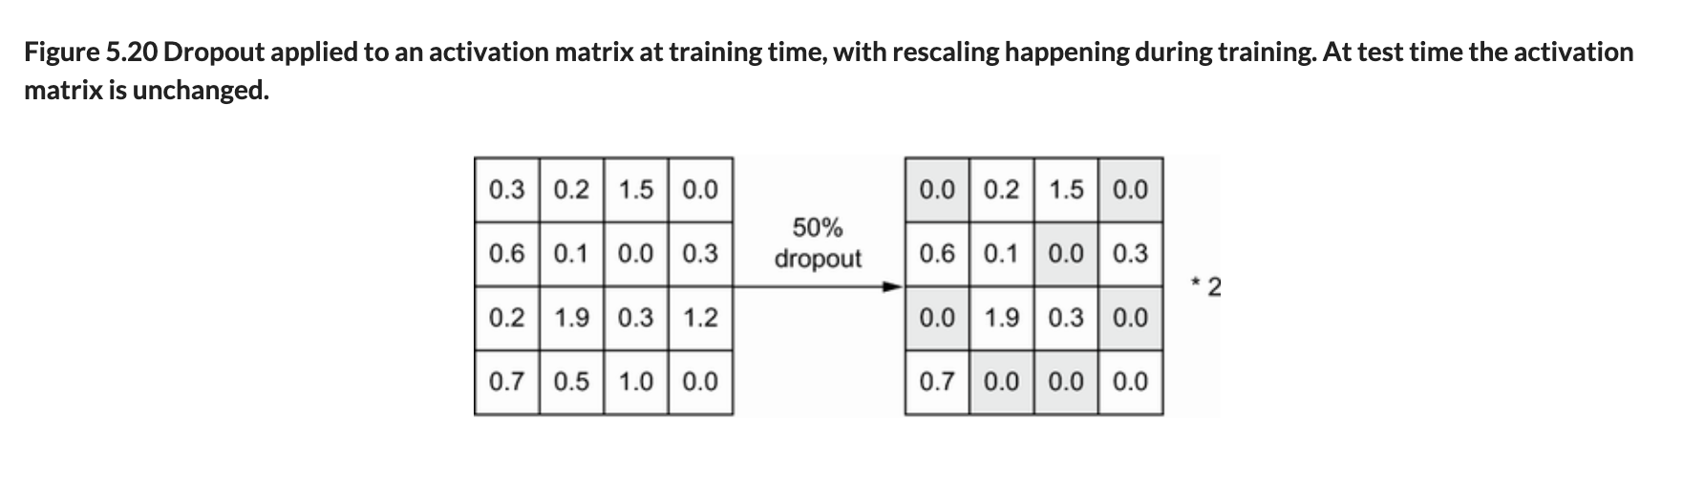
Dropout
Adding Dropout Layers to the Network
Dropout layers set a random proportion of edge weights to 0 in a given training iteration. Typically, between 20% and 50% of edges.
Note that this ‘zeroing out’ of weights is not retained in the final trained model.

Slide 10
Batch Normalization
Re-scales batch coming into each layer, to make it unit-normal distributed.
The primary reason for these layers is to improve/speed up training. Absent this, changes to up-funnel weights cause ‘shifts’ in the distribution of data entering later layers. Later layers’ weights need to be updated constantly to adapt to those up-stream shifts. Batch normalization removes this issue.
A by-product of batch normalization is that it acts like a weak form of Dropout, because normalization is implemented based on the current batch of data. Mean and variance estimates from the current batch are a noisy reflection of population mean and variance. Hence, we get some noise being injected in the training process as a result.

Slide 11
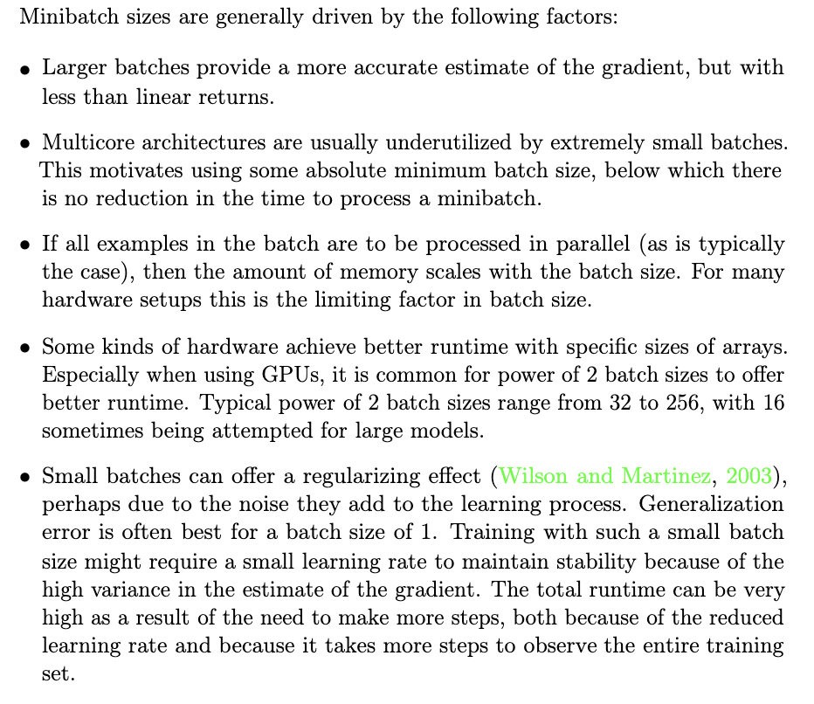
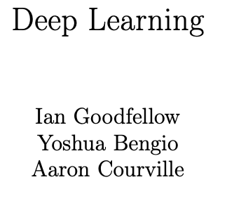
Adjust Batch Size

Slide 12

Gaussian Noise
You can use this layer to simply inject noise into the data in the middle of the network.
There are ways to add noise to any model component, including the inputs, weights and activations.

Slide 13

Get More Data (Idiosyncrasies Play Lesser Role)!
More Training Examples
Means you can have a bigger training data-set, which will presumably contain more information for the model to extract and any given noise players a weaker role. This is the approach that often yields the best marginal returns, though it can also be most costly.

Slide 14
Some Rules of Thumb
These Are Useful Guidelines for Your First Pass at a NN
Start with 2 hidden layers.
Give the first hidden layer (num_inputs / 2) nodes and the next (num_inputs / 4) nodes. If you add layers, decay the node count in this manner as you go along.
Use ReLU activations for hidden layers.
Add Dropout at every layer after the input, with a rate of 0.5 (don’t push beyond 0.5).
If learning is flat, then add more nodes in each layer.
Whiten continuous input data (de-mean, divide by standard deviation).
Ensure that you are performing cross-validation or evaluating against a test set holdout.
For classification problems, apply class weights to balance labels (in the model.fit() function).
Use RMSprop or Adam as your first optimizer.
Check that your loss function makes sense given your label value ranges. Also, check that your output layer activation makes sense!
Monitor accuracy as a metric for classification problems, MSE or MAE for regression.
Start with 20 epochs, increase if the validation loss has not yet plateaued.
Start with a batch size of 16 and then double it to see effect on model performance.

Slide 15
Past Project Examples
Examples of Past Student Projects That Had Some Success
Detect defects in images of leather samples (quality assurance).
Classify the ‘grade’ of a marble slab based on its photo (approximate value of the sample).
Detect ‘out of control’ fires to notify emergency responders (based on CCTV images).
Label whether images of refuse contain recyclable materials or not.
Recommend an appropriate ‘top’ for a pair of pants, or vice versa.
Predict the calorie content from a recipe.
Detect whether a driver’s eyes are not on the road.
Predict whether a review is likely to be ‘helpful’ to other consumers.
Examples of Past Student Projects That Struggled
Predict stock price movements using textual data from Reddit posts.
Forecast sales at Walmart locations.
Predict engagement with a YouTube video based on its thumbnail and creator features.
Translating sign language into written text.
Classifying actions from sports video recordings.
Predicting pass success from professional hockey data.

Slide 16
Assignment 1
Basic Prediction Exercise
I will provide you with a sample of real data from the Blue Bikeshare service (Boston bikeshare).
Your goal is to use this data to predict how long an individual’s bike rental / trip will last (at the time they begin the rental). You will see instructions for the assignment on Github.
Deliverable
Produce a Colab notebook documenting your work. Submit the .ipynb file via Blackboard before the assignment deadline.
Make sure you comment your code well and follow the provided template so I am clear what you were trying to do!
Answer conceptual questions laid out in the assignment document.
Document your use of GenAI tools (include the prompts you used and screenshot output).
State which other students you spoke to / interacted with when brainstorming how to solve the assignment.
Notes:
Note that I don’t expect you to implement a neural network from scratch. This is just to give you an understanding of how they work.

Slide 17
I’ll Post in a Sec, and You Can Start Working Now…
Notes:
Note that I don’t expect you to implement a neural network from scratch. This is just to give you an understanding of how they work.

